Slide 1
Lecture 30: Working with Files
CSC111: Introduction to CS through Programming
R. Jordan Crouser
Assistant Professor of Computer Science
Smith College

Slide 2
Announcements: Smithies in CS events

Slide 3
Announcements: auto-extension on A6
This week is a rough one for a lot of us
A6 now due Monday 11/9 for everyone (+3 days)
Take care of yourselves: remember that you have a free from of one lab and one assignment

Slide 4
Outline
Announcements
Working with files
what is a file?
reading data in
writing data out
*some details about the final project*
Lab: Sorting
Life Skill #5: Code Diagrams
Useful python packages

Slide 5

RECAP: how does a hard drive work?

Slide 6
RECAP: how does a hard drive work?

Slide 7
RECAP: how does a hard drive work?

Slide 8
RECAP: how does a hard drive work?

Slide 9
RECAP: how does a hard drive work?

Slide 10
RECAP: how does a hard drive work?

Slide 11
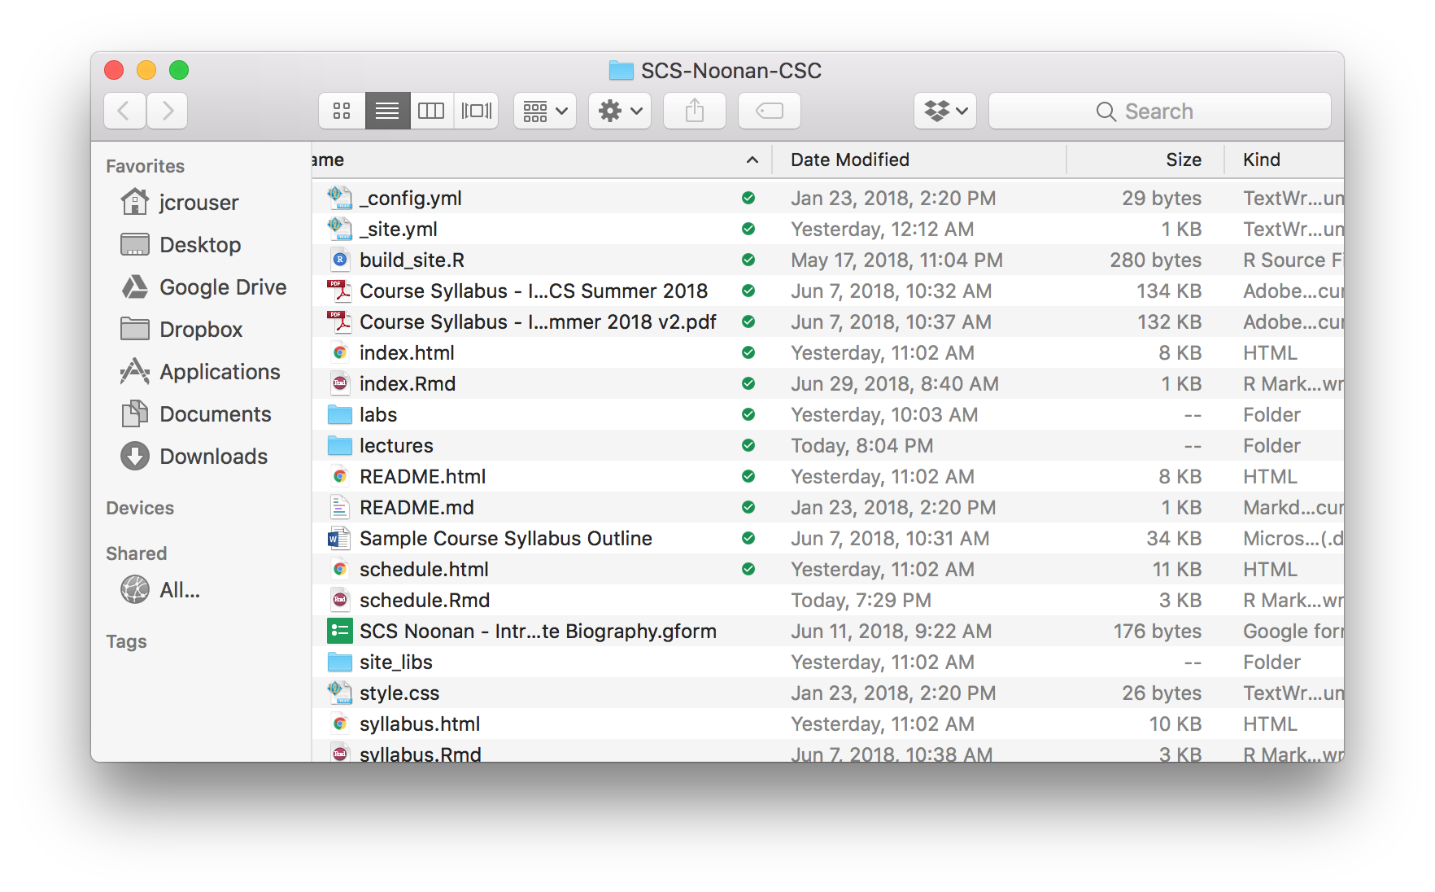
What is a file?

Slide 12
Working with files
Containers of bits, organized into bytes
Could represent text, images, music, movies, programs, applications, list of files (folders)… but underneath, they’re all the same: 0s and 1s
We’ll start by playing with text files

Slide 13
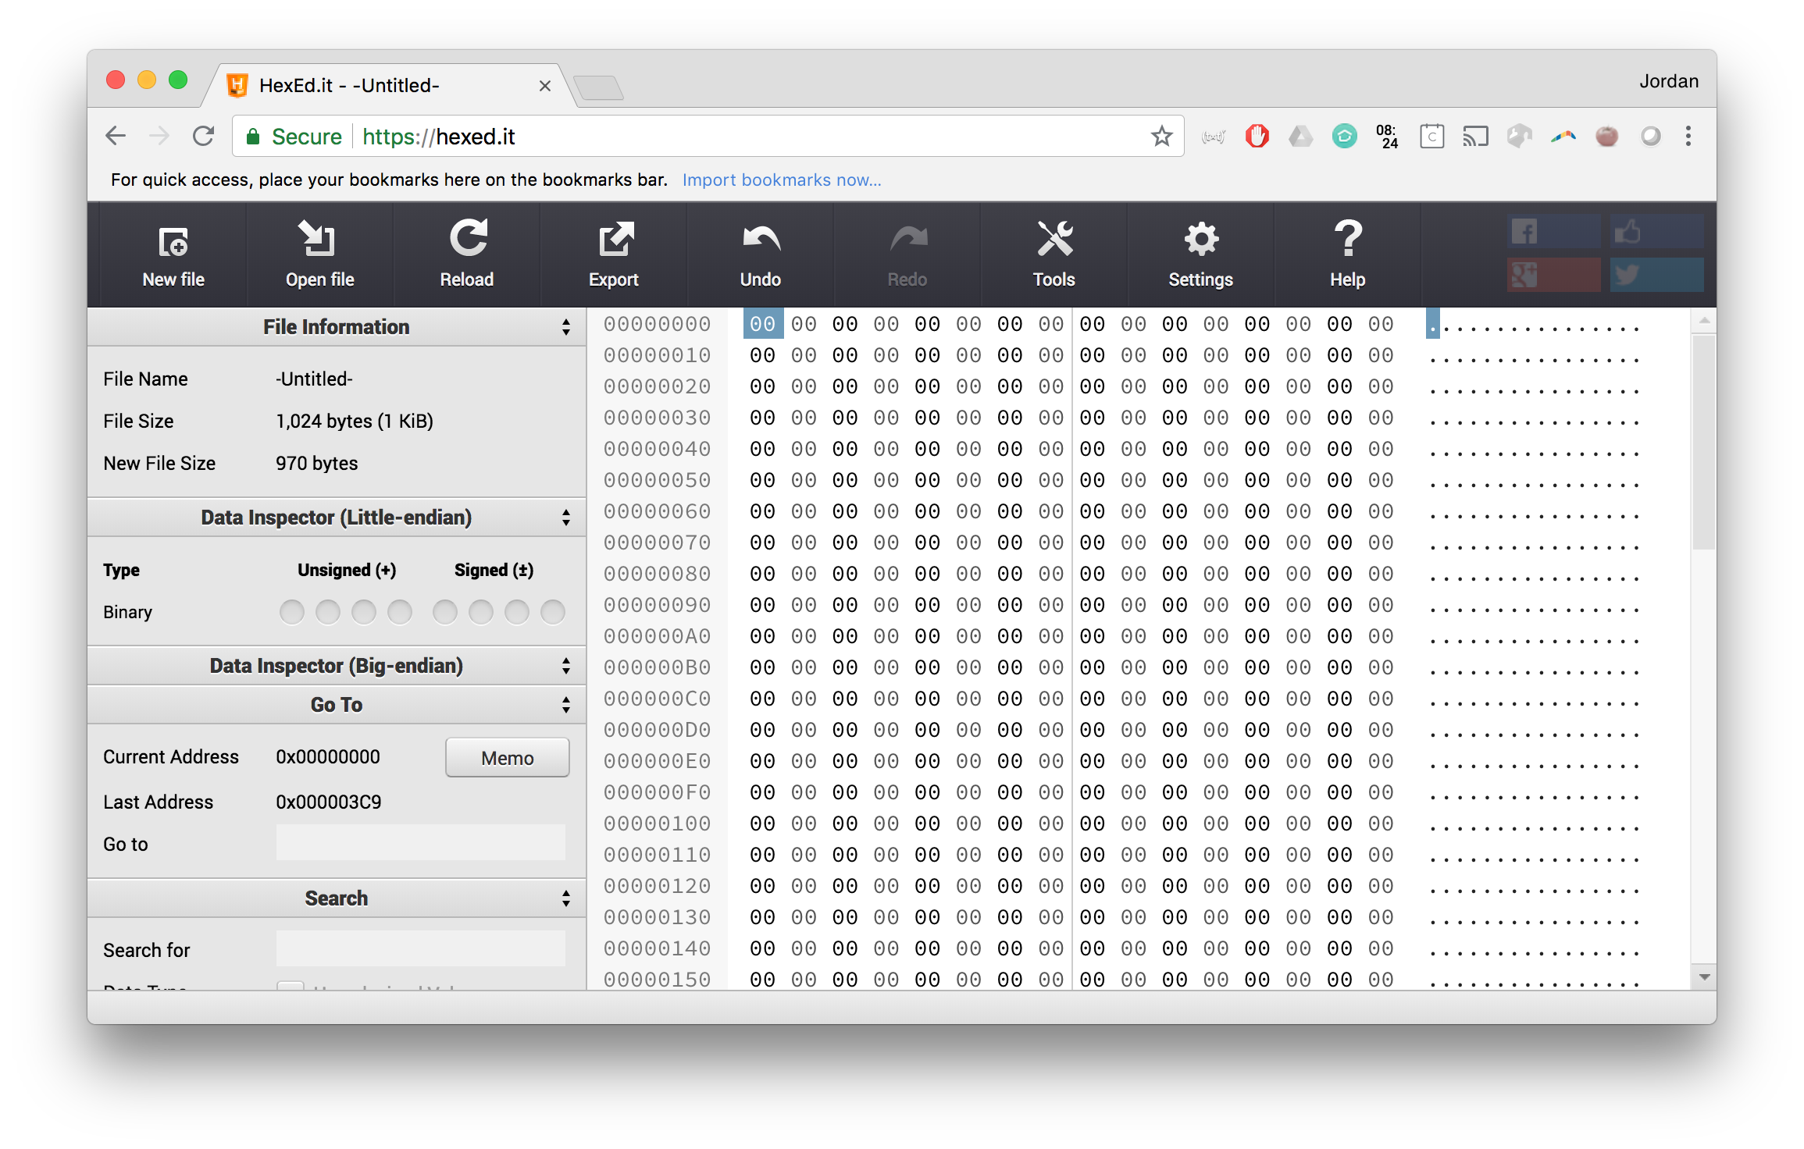
Demo: looking inside a text file

Slide 14
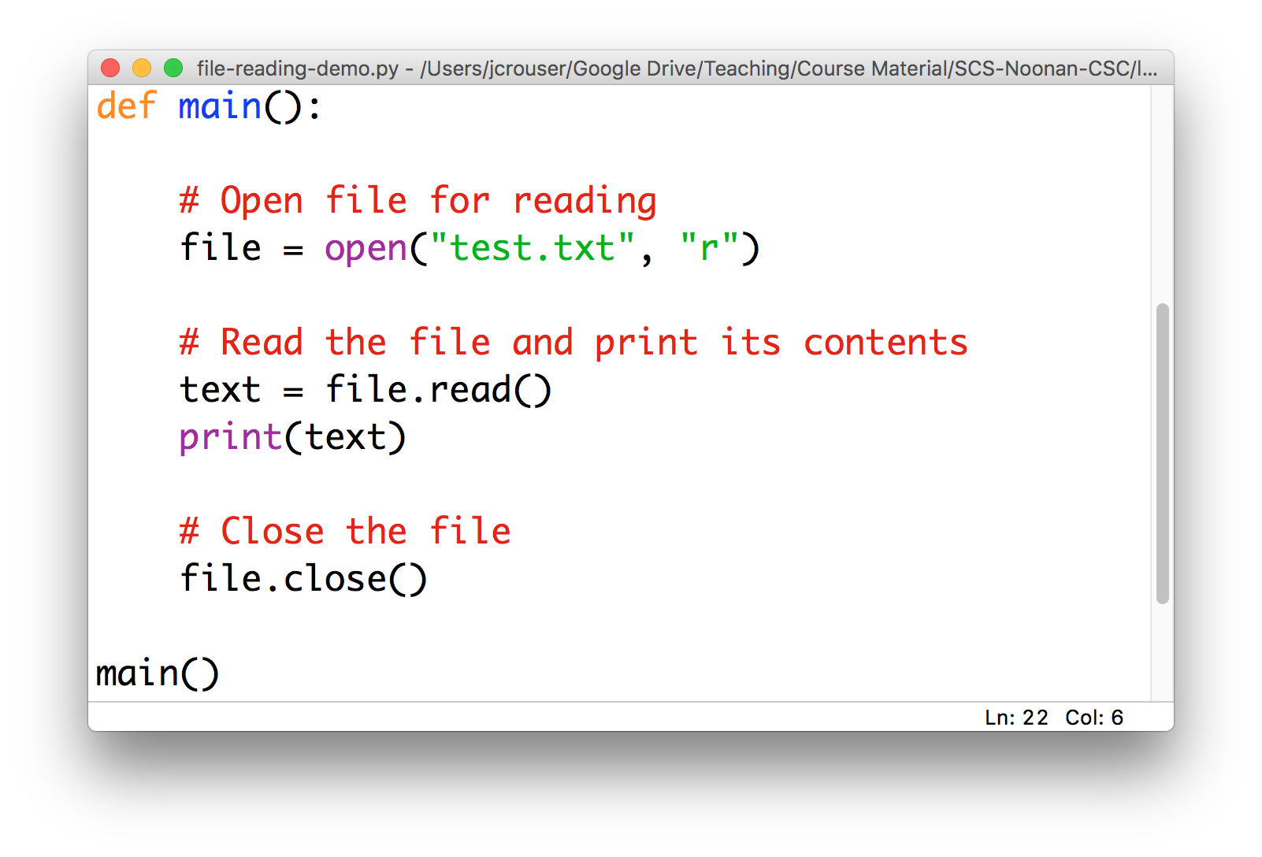
Reading a text file
In order to bring data stored in a text file into a Python program, we need to read it:

Slide 15
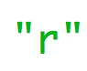
Reading a text file
In order to bring data stored in a text file into a Python program, we need to read it:
“r” stands for
READ-MODE

Slide 16

Reading a text file
In order to bring data stored in a text file into a Python program, we need to read it:
as with email or texts
opening != reading

Slide 17
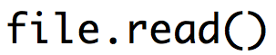
Reading a text file
In order to bring data stored in a text file into a Python program, we need to read it:
file is now an object
with a .read() method
that returns a string

Slide 18
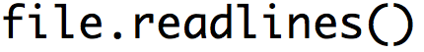
Reading a text file
In order to bring data stored in a text file into a Python program, we need to read it:
it also has a
.readlines() method
that returns a list of strings

Slide 19
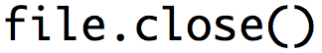
Reading a text file
In order to bring data stored in a text file into a Python program, we need to read it:
after you .read() or .readlines()
a file, remember to .close() it

Slide 20
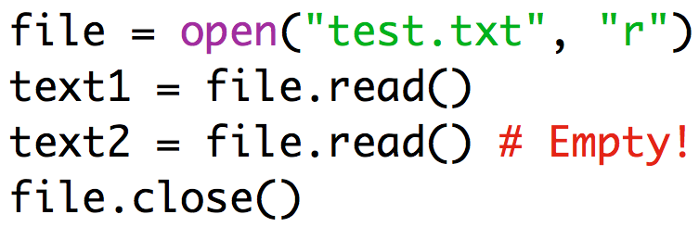
Key points for reading files
Three-step process:
.open()
.read() or .readlines()
.close()
All three steps, always in that order
If you want to .read() a file multiple times, you have to repeat the whole process

Slide 21
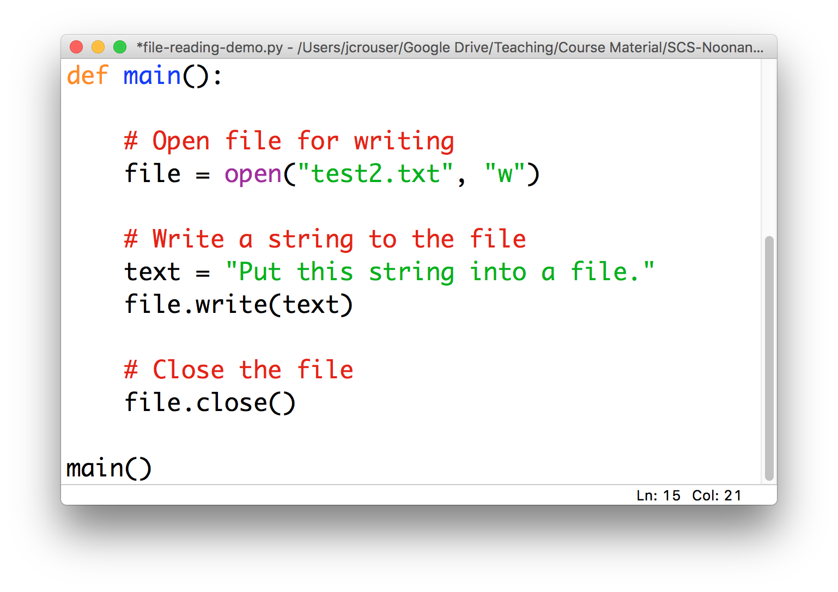
Writing data to a text file
The process looks very similar when we want to write data to a file:

Slide 22
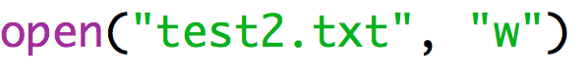
Writing data to a text file
The process looks very similar when we want to write data to a file:
exactly the same function
to .open() a file

Slide 23
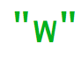
Writing data to a text file
The process looks very similar when we want to write data to a file:
“w” stands for
WRITE-MODE

Slide 24
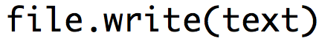
Writing data to a text file
The process looks very similar when we want to write data to a file:
file is now an object
with a .write() method
that takes in a string

Slide 25
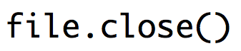
Writing data to a text file
The process looks very similar when we want to write data to a file:
as before, after you .write() to a file
remember to .close() it

Slide 26
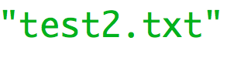
Writing data to a text file
Some quirks to be aware of when writing to files:
if this file doesn’t exist
Python will create it

Slide 27
Writing data to a text file
Some quirks to be aware of when writing to files:
if this file does exist
Python will overwrite it

Slide 28
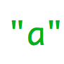
Writing data to a text file
Some quirks to be aware of when writing to files:
if you want to
add to an existing file
instead of overwrite it
“a” stands for
APPEND-MODE

Slide 29
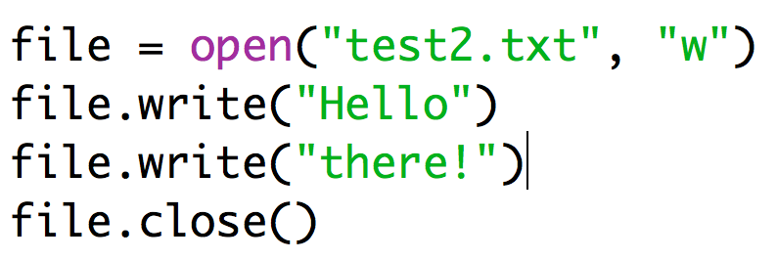
Key points for writing to files
Three-step process:
.open()
.write()
.close()
Unlike .read(), you can .write() to an .open() file as many times as you want (appending each time)
If you want a new line, you have to add it yourself! (\n)

Slide 30
15-minute exercise: read and write
Fork: https://repl.it/@JordanCrouser/horizontal-vertical
Write a program that:
reads the file horizontal.txt
breaks it into individual words
and writes the words to a new file vertical.txt, each one on its own line

Slide 31
Discussion
What did you come up with?

Slide 32
About the final project
Four weeks of class left! (time to talk about the final)
Goal of the project: apply the techniques we’ve learned in this class to something you care about
Ideas:
an computer-generated animation
a custom game
a tool to help plan your path through the major
a automatic poem generator
a graphing calculator program
anything else you can think of!

Slide 33
Final project details and deliverables
Recommendation: work in teams of 2-5 people
Deliverables:
Friday Nov 13th: Final Project Proposal
Friday November 20th: Prototype I
Monday November 30th: Prototype II
Thursday December 17th: Final Write-Up (solo or group)

Slide 34
FP1: final project proposal
Names of people working on this project
What's the big idea behind this project?
What are the (major) building blocks the project will need to be successful?
Which do you know how to build already, and which ones do you still need to figure out?
Are there any potential roadblocks?

Slide 35
Coming up
Announcements
Working with files
what is a file?
reading data in
writing data out
*some details about the final project*
Lab: Sorting
Life Skill #5: Code Diagrams
Useful python packages

